Slide 1
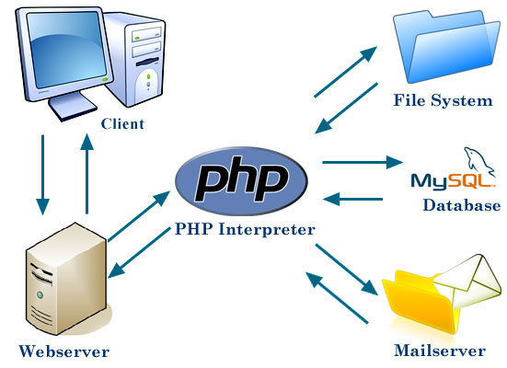
PHP lab 1
Samar Abdelghani
Demonstrator, CS Department,

Slide 2
WEB SERVER
Gets Page
<HTML>
<?php PHP code ?>
</HTML>
HTTP Request
(url)
Interprets the PHP code
Server response
<HTML>
<B>Hello</B>
</HTML>
CLIENT
Hello
Browser creates
the web page

Slide 3
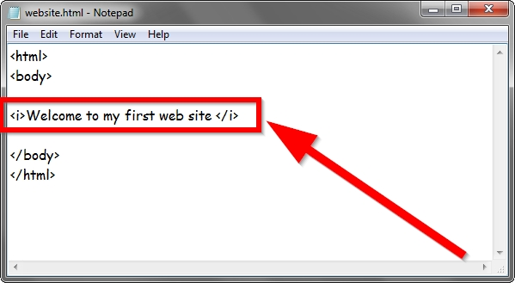
HTML
Used Technologies
Hypertext Markup Language, a standardized system for tagging text files to achieve font, colour, graphic, and hyperlink effects on World Wide Web pages.

Slide 4
Used Technologies
CCS
Cascading Style Sheets (CSS): style sheet language used to describe the presentation of a html document.
Define colors, fonts, layout, and other aspects of document
Why CSS?
more flexibility
control the specification of presentational characteristics
reduce complexity and repetition in the structural content.

Slide 5
Used Technologies
Javascript
JavaScript is a scripting language most often used for client-side.
JS functions are embedded in HTML pages and interact with the Document Object Model (DOM) of the page
Respond to user actions quickly, making an application feel more responsive
Detect user actions which HTML alone cannot

Slide 6

Used Technologies
PHP
Personal Home Page (PHP)
PHP recursive acronym for "PHP:Hypertext Preprocessor“
Widely-used Open Source scripting language
Especially suited for Web development
Used for producing dynamic web pages
Can be embedded into HTML.

Slide 7
Used Technologies
PHP
Hypertext Preprocessor
PHP includes a large number of free and open source libraries
Real Object Oriented Programming Language
Commonly install on Apache Server allow to interact with Database like Mysql
PHP is mainly focused on server-side scripting

Slide 8
Where does PHP fit ?
Used Technologies
server
Page
HTTP
Request
Added functionality
Internet or
Web
Intranet
Server
Web Browser
Web
Web
page
page
Server-side “Dynamic pages”
CGI, SSI, Server API, ASP, JSP, PHP, COM/DCOM, CORBA
Client-side “Active pages”
JavaScript, VBScript, Applet, ActiveX
Active and dynamic page technology can be used together – server-side program generates customized active pages.

Slide 9


Used Technologies
PHP - Communication client-server
Web-Client
Web-Server
HTML-Form
Submit
Form Data
WWW
Call PHP
interpreter
Web-Browser
PHP
Script
Response
Response
Reply
PHP generally runs on a web server, taking PHP code as its input
and creating Web pages as output

Slide 10
PHP vs. JSP
PHP is faster in execution time
A recent survey in ZDnet's eWeek online publication found that PHP is as much as 3.5 times faster than JSP
Faster in development time – flatter learning curve
PHP supports any 32-bit or better platform, whereas JSP supports only platforms that have a Java virtual machine available
Notes:
Because JSP is based on Java, a strongly typed language, we had to declare the types of variables we used and manually convert between types when necessary. This makes JSP the hardest of the scripting languages we tested for nonprogrammers to learn...
PHP is very easy to learn because the core language of PHP is quite small, and the constructs are similar to Javascript. As a bonus, many basic HTTP concepts are built into the language.

Slide 11
PHP vs. ASP
PHP is faster
Superior Memory Management
Closer to C Style of Programming
Cross Platform Migration Strategy
Dynamic generation of UI is more flexible

Slide 12

Used Technologies
MySQL
MySQL is a multithreaded, multi-user SQL database management system.
Popular for web applications.
Closely tied to PHP.
Allow all sort of queries.
PhpMyAdmin: friendly user interface to manage database develop on PHP.

Slide 13
What we'll cover
PHP Introduction
PHP Variables.
PHP Comments.
PHP Operators.
PHP Conditional Statements.
PHP Loops.
PHP Arrays
PHP Functions

Slide 14
PHP Introduction
PHP == ‘Hypertext Preprocessor’
Open-source, server-side scripting language
Used to generate dynamic web-pages
PHP scripts reside between reserved PHP tags
This allows the programmer to embed PHP scripts within HTML pages

Slide 15
PHP Introduction
> PHP is a server-side scripting language
> PHP scripts are executed on the server
> PHP supports many databases (MySQL, Informix, Oracle, Sybase, Solid, PostgreSQL, Generic ODBC, etc.)‏
> PHP is open source software
> PHP is free to download and use

Slide 16
PHP Introduction
> PHP runs on different platforms (Windows, Linux, Unix, etc.)‏
> PHP is compatible with almost all servers used today (Apache, IIS, etc.)‏
> PHP is FREE to download from the official PHP resource: www.php.net
> PHP is easy to learn and runs efficiently on the server side

Slide 17
PHP Introduction
Some info on MySQL which we will cover in the next workshop...
> MySQL is a database server
> MySQL is ideal for both small and large applications
> MySQL supports standard SQL
> MySQL compiles on a number of platforms
> MySQL is free to download and use

Slide 18
What does PHP code look like?
PHP Introduction
Structurally similar to C/C++
Supports procedural and object-oriented paradigm (to some degree)
All PHP statements end with a semi-colon
Each PHP script must be enclosed in the reserved PHP tag
<?php
… ?>

Slide 19
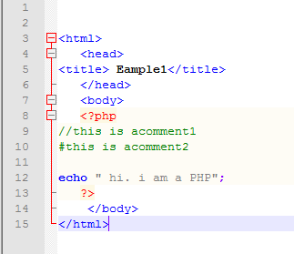
PHP Introduction

Slide 20
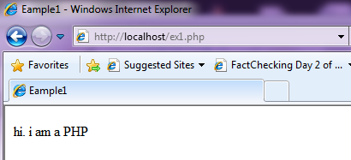
PHP Introduction

Slide 21
PHP Introduction
PHP code is executed on the server, generating HTML which is then sent to the client. The client would receive the results of running that script, but would not know what the underlying code was.
A visual, if you please...

Slide 22
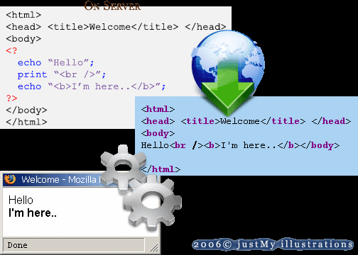
PHP Introduction

Slide 23
PHP Getting Started
On windows, you can download and install WAMP. With one installation and you get an Apache webserver, database server and php.
http://www.wampserver.com
On mac, you can download and install MAMP.
http://www.mamp.info/en/index.html

Slide 24
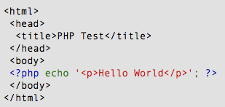
PHP Hello World
Above is the PHP source code.

Slide 25
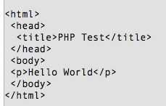
PHP Hello World
It renders as HTML that looks like this:

Slide 26
PHP Hello World
This program is extremely simple and you really did not need to use PHP to create a page like this. All it does is display: Hello World using the PHP echo() statement.
Think of this as a normal HTML file which happens to have a set of special tags available to you that do a lot of interesting things.

Slide 27
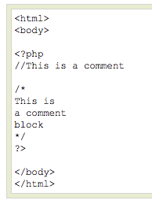
PHP Comments
In PHP, we use // to make a single-line comment or /* and */ to make a large comment block.

Slide 28

PHP Variables
Variables are used for storing values, like text strings, numbers or arrays.
When a variable is declared, it can be used over and over again in your script.
All variables in PHP start with a “$” sign symbol.
Case-sensitive ($Foo != $foo != $fOo)
The correct way of declaring a variable in PHP:

Slide 29

PHP Variables
In PHP, a variable does not need to be declared before adding a value to it.
In the example above, you see that you do not have to tell PHP which data type the variable is.
PHP automatically converts the variable to the correct data type, depending on its value.

Slide 30
PHP Variables
> A variable name must start with a letter or an underscore "_" -- not a number
> A variable name can only contain alpha-numeric characters, underscores (a-z, A-Z, 0-9, and _ )‏
> A variable name should not contain spaces. If a variable name is more than one word, it should be separated with an underscore ($my_string) or with capitalization ($myString)‏

Slide 31
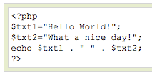
PHP Concatenation
> The concatenation operator (.) is used to put two string values together.
> To concatenate two string variables together, use the concatenation operator:

Slide 32

PHP Concatenation
The output of the code on the last slide will be:
If we look at the code you see that we used the concatenation operator two times. This is because we had to insert a third string (a space character), to separate the two strings.

Slide 33
Echo
The PHP command ‘echo’ is used to output the parameters passed to it
The typical usage for this is to send data to the client’s web-browser

Slide 34
Echo example
<?php
$foo = 25; // Numerical variable $bar = “Hello”; // String variable
echo $bar; // Outputs Hello
echo $foo,$bar; // Outputs 25Hello
echo “5x5=”,$foo; // Outputs 5x5=25
echo “5x5=$foo”; // Outputs 5x5=25 echo ‘5x5=$foo’; // Outputs 5x5=$foo
?>
Notice how echo ‘5x5=$foo’ outputs $foo rather than replacing it with 25
Strings in single quotes (‘ ’) are not interpreted or evaluated by PHP
This is true for both variables and character escape-sequences (such as “\n” or “\\”)

Slide 35
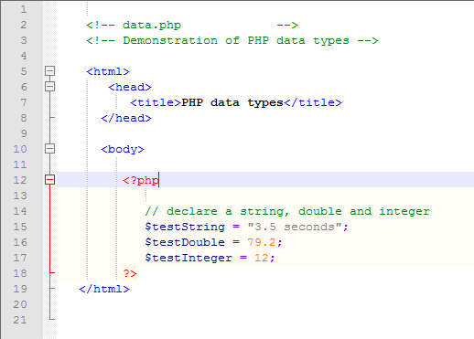
PHP Variables
Assign a string to variable $testString
Assign a double to variable $testDouble
Assign an integer to variable $testInteger

Slide 36
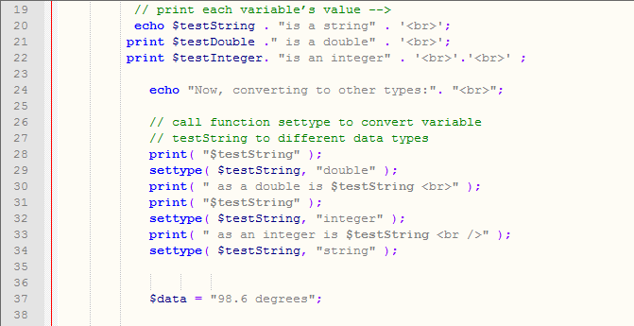
PHP Variables
Print each variable’s value
Call function settype to convert the data type of variable $testString to a double.
Call function settype to convert the data type of variable $testString to an integer.
Convert variable $testString back to a string

Slide 37
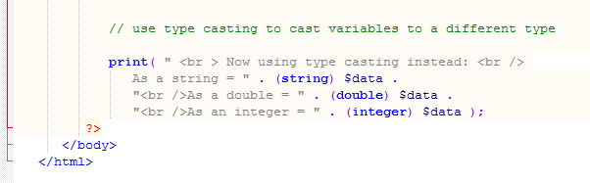
PHP Variables
Use type casting to cast variable $data to different types

Slide 38
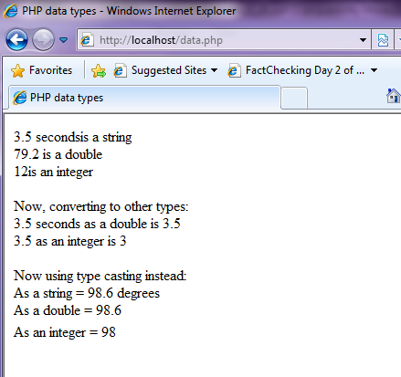
PHP Variables

Slide 39
PHP Operators
Operators are used to operate on values. There are four classifications of operators:
> Arithmetic
> Assignment
> Comparison
> Logical

Slide 40
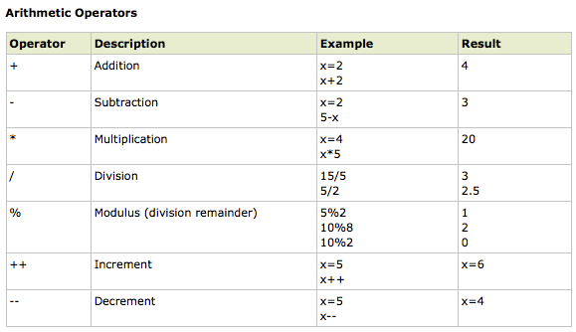
PHP Operators

Slide 41
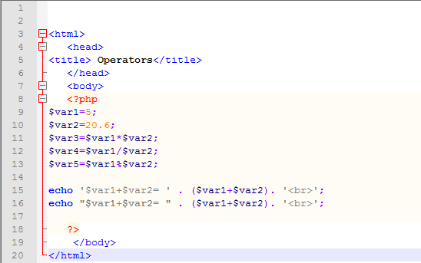
PHP Operators

Slide 42
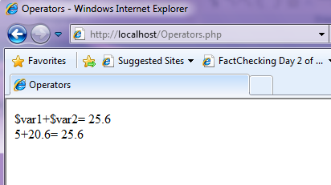
PHP Operators

Slide 43
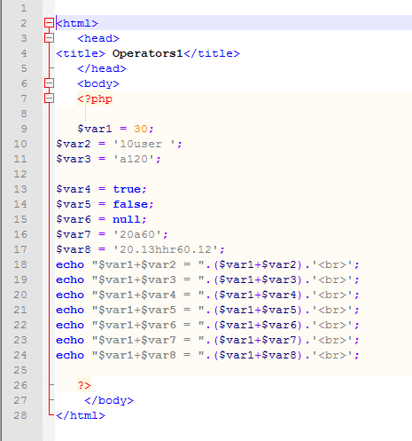
PHP Operators

Slide 44
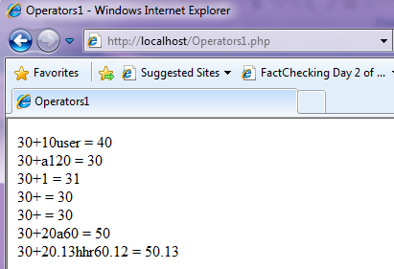
PHP Operators

Slide 45
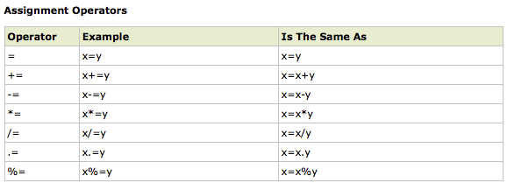
PHP Operators

Slide 46
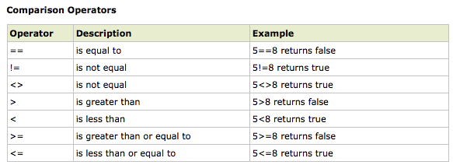
PHP Operators

Slide 47
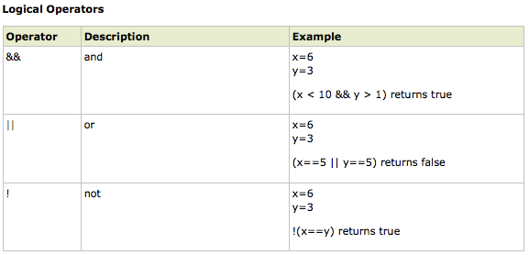
PHP Operators

Slide 48
PHP Conditional Statements
> Very often when you write code, you want to perform different actions for different decisions.
> You can use conditional statements in your code to do this.
> In PHP we have the following conditional statements...

Slide 49
PHP Conditional Statements
> if statement - use this statement to execute some code only if a specified condition is true
> if...else statement - use this statement to execute some code if a condition is true and another code if the condition is false
> if...elseif....else statement - use this statement to select one of several blocks of code to be executed
> switch statement - use this statement to select one of many blocks of code to be executed

Slide 50
PHP Conditional Statements
Example if/else if/else statement:
if ($foo == 0) {
echo ‘The variable foo is equal to 0’;
}
else if (($foo > 0) && ($foo <= 5)) {
echo ‘The variable foo is between 1 and 5’;
}
else {
echo ‘The variable foo is equal to ‘.$foo;
}

Slide 51
If ... Else...
<?php
If($user==“John”)
{
Print “Hello John.”;
}
Else
{
Print “You are not John.”;
}
?>
If (condition)
{
Statements;
}
Else
{
Statement;
}
No THEN in PHP

Slide 52
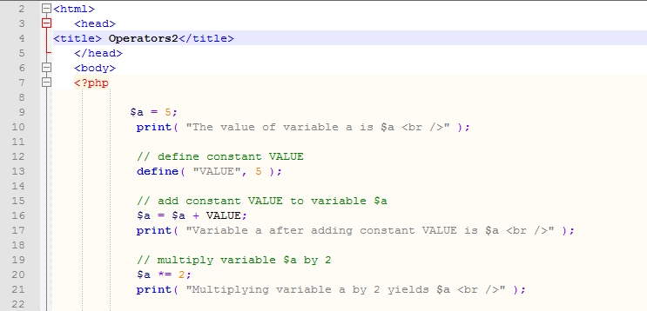
PHP Conditional Statements
Define constant VALUE.
Add constant VALUE to variable $a.
Multiply variable $a by two using the multiplication assignment operator *=.

Slide 53
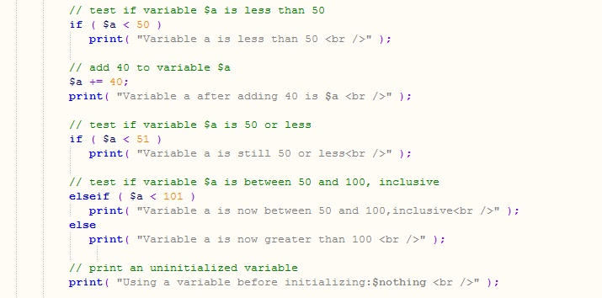
PHP Conditional Statements
Test whether variable $a is less than 50
Print if variable $a is less than 50.
Add 40 to variable $a using the addition assignment operator +=.

Slide 54
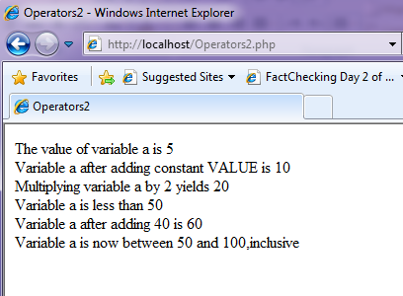
PHP Conditional Statements

Slide 55
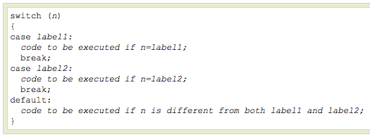
PHP Conditional Statements
Use the switch statement to select one of many blocks of code to be executed.

Slide 56
PHP Conditional Statements
For switches, first we have a single expression n (most often a variable), that is evaluated once.
The value of the expression is then compared with the values for each case in the structure. If there is a match, the block of code associated with that case is executed.
Use break to prevent the code from running into the next case automatically. The default statement is used if no match is found.

Slide 57
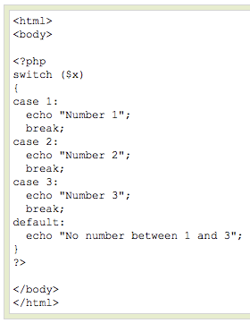
PHP Conditional Statements

Slide 58
PHP Loops
> Often when you write code, you want the same block of code to run over and over again in a row. Instead of adding several almost equal lines in a script we can use loops to perform a task like this.
> In PHP, we have the following looping statements:

Slide 59
PHP Loops
> while - loops through a block of code while a specified condition is true
> do...while - loops through a block of code once, and then repeats the loop as long as a specified condition is true
> for - loops through a block of code a specified number of times
> foreach - loops through a block of code for each element in an array

Slide 60
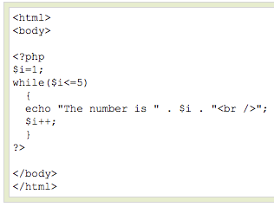
PHP Loops - While
The while loop executes a block of code while a condition is true. The example below defines a loop that starts with
i=1. The loop will
continue to run as
long as i is less
than, or equal to 5.
i will increase by 1
each time the loop
runs:

Slide 61
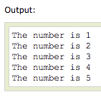
PHP Loops - While

Slide 62
PHP Loops – Do ... While
The do...while statement will always execute the block of code once, it will then check the condition, and repeat the loop while the condition is true.
The next example defines a loop that starts with i=1. It will then increment i with 1, and write some output. Then the condition is checked, and the loop will continue to run as long as i is less than, or equal to 5:

Slide 63
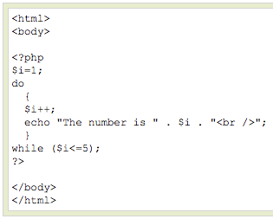
PHP Loops – Do ... While

Slide 64
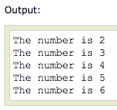
PHP Loops – Do ... While

Slide 65
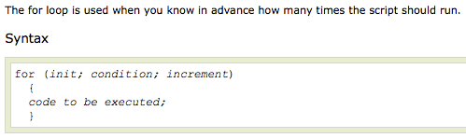
PHP Loops - For

Slide 66
PHP Loops - For
Parameters:
> init: Mostly used to set a counter (but can be any code to be executed once at the beginning of the loop)‏
> condition: Evaluated for each loop iteration. If it evaluates to TRUE, the loop continues. If it evaluates to FALSE, the loop ends.
> increment: Mostly used to increment a counter (but can be any code to be executed at the end of the loop)‏

Slide 67
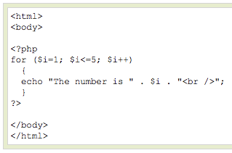
PHP Loops - For
The example below defines a loop that starts with i=1. The loop will continue to run as long as i is less than, or equal to 5. i will increase by 1 each time the loop runs:

Slide 68
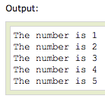
PHP Loops - For

Slide 69

PHP Loops - Foreach
For every loop iteration, the value of the current array element is assigned to $value (and the array pointer is moved by one) - so on the next loop iteration, you'll be looking at the next array value.

Slide 70
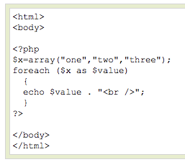
PHP Loops - Foreach
The following example demonstrates a loop that will print the values of the given array:

Slide 71

PHP Loops - Foreach
Winner of the most impressive slide award

Slide 72
PHP Arrays
> An array variable is a storage area holding a number or text. The problem is, a variable will hold only one value.
> An array is a special variable, which can store multiple values in one single variable.

Slide 73

PHP Arrays
If you have a list of items (a list of car names, for example), storing the cars in single variables could look like this:

Slide 74
PHP Arrays
> However, what if you want to loop through the cars and find a specific one? And what if you had not 3 cars, but 300?
> The best solution here is to use an array.
> An array can hold all your variable values under a single name. And you can access the values by referring to the array name.
> Each element in the array has its own index so that it can be easily accessed.

Slide 75
PHP Arrays
In PHP, there are three kind of arrays:
> Numeric array - An array with a numeric index
> Associative array - An array where each ID key is associated with a value
> Multidimensional array - An array containing one or more arrays

Slide 76
PHP Numeric Arrays
> A numeric array stores each array element with a numeric index.
> There are two methods to create a numeric array.

Slide 77


PHP Numeric Arrays
In the following example the index is automatically assigned (the index starts at 0):
In the following example we assign the index manually:

Slide 78
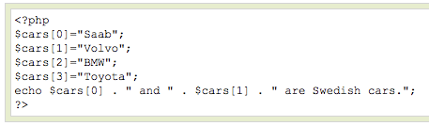

PHP Numeric Arrays
In the following example you access the variable values by referring to the array name and index:
The code above will output:

Slide 79
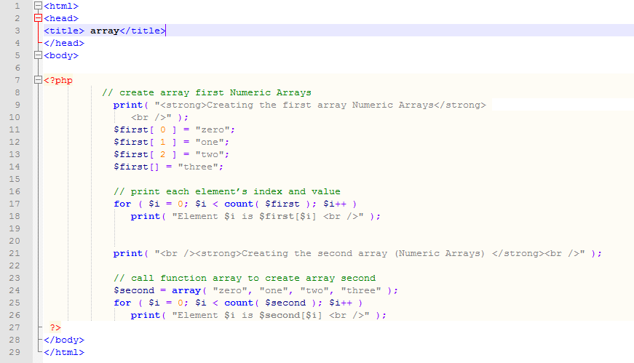
PHP Numeric Arrays
Create the array $first by assigning a value to an array element.
Assign a value to the array, omitting the index. Appends a new element to the end of the array.
Use a for loop to print out each element’s index and value. Function count returns the total number of elements in the array.
Call function array to create an array that contains the arguments passed to it. Store the array in variable $second.

Slide 80
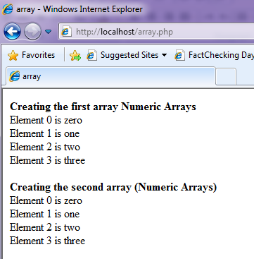
PHP Numeric Arrays

Slide 81
PHP Associative Arrays
> With an associative array, each ID key is associated with a value.
> When storing data about specific named values, a numerical array is not always the best way to do it.
> With associative arrays we can use the values as keys and assign values to them.

Slide 82

PHP Associative Arrays
In this example we use an array to assign ages to the different persons:
This example is the same as the one above, but shows a different way of creating the array:

Slide 83
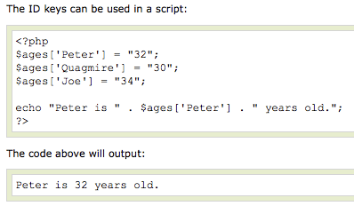
PHP Associative Arrays

Slide 84
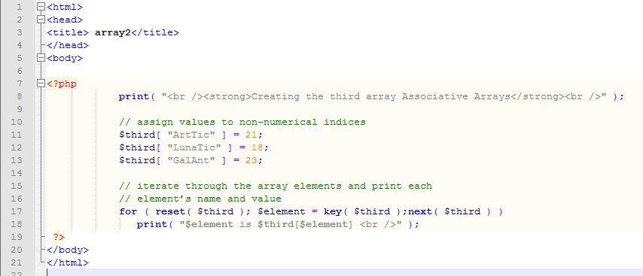
PHP Associative Arrays
Assign values to non-numerical indices in array $third.
Function reset sets the internal pointer to the first element of the array.
Function next moves the internal pointer to the next element.
Function key returns the index of the element which the internal pointer references.

Slide 85
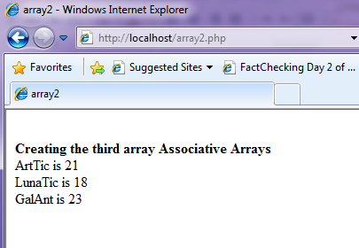
PHP Associative Arrays

Slide 86
PHP Multidimensional Arrays
In a multidimensional array, each element in the main array can also be an array.
And each element in the sub-array can be an array, and so on.

Slide 87
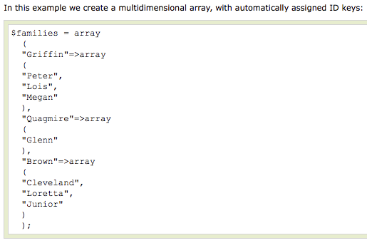
PHP Multidimensional Arrays

Slide 88
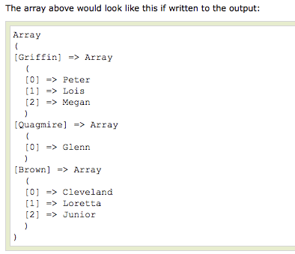
PHP Multidimensional Arrays

Slide 89
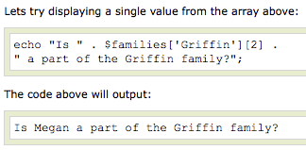
PHP Multidimensional Arrays

Slide 90
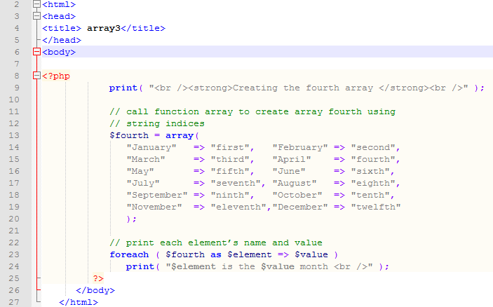
PHP Multidimensional Arrays
Operator => is used in function array to assign each element a string index. The value to the left of the operator is the array index, and the value to the right is the element’s value.

Slide 91
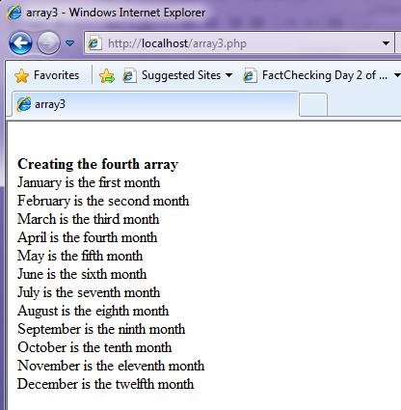
PHP Multidimensional Arrays

Slide 92
Arrays
array() = creates arrays
<?php
$arr = array("foo" => "bar", 12 => true);
echo $arr["foo"]; // bar
echo $arr[12]; // 1
?>
key = either an integer or a string.
value = any PHP type.
if no key given (as in example), the PHP interpreter uses (maximum of the integer indices + 1).
if an existing key, its value will be overwritten.
<?php
array(5 => 43, 32, 56, "b" => 12);
array(5 => 43, 6 => 32, 7 => 56, "b" => 12);
?>

Slide 93
PHP Functions
> We will now explore how to create your own functions.
> To keep the script from being executed when the page loads, you can put it into a function.
> A function will be executed by a call to the function.
> You may call a function from anywhere within a page.

Slide 94

PHP Functions
A function will be executed by a call to the function.
> Give the function a name that reflects what the function does
> The function name can start with a letter or underscore (not a number)‏

Slide 95
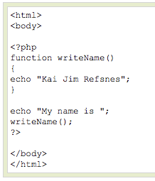
PHP Functions
A simple function that writes a name when it is called:

Slide 96
PHP Functions - Parameters
Adding parameters...
> To add more functionality to a function, we can add parameters. A parameter is just like a variable.
> Parameters are specified after the function name, inside the parentheses.

Slide 97
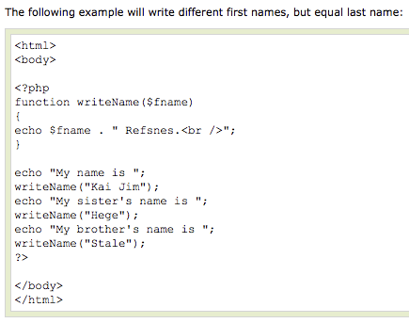
PHP Functions - Parameters

Slide 98

PHP Functions - Parameters

Slide 99
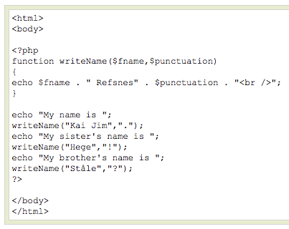
PHP Functions - Parameters
This example adds different punctuation.

Slide 100

PHP Functions - Parameters

Slide 101
Functions example
<?php
// This is a function
function foo($arg_1, $arg_2)
{ $arg_2 = $arg_1 * $arg_2;
return $arg_2; }
$result_1 = foo(12, 3); // Store the function
echo $result_1; // Outputs 36
echo foo(12, 3); // Outputs 36
?>

Slide 102
Lab Activities:
Write php script to draw engineering shapes.
➔ diamond, parallelogram, triangle

